Slide 1
POINTERS

Slide 2
Pointers
simply memory addresses
Already used with arrays passed as parameters – always reference variable reference variables are actually pointers
Name of an array returns the address where the array is stored in memory. i.e. a pointer to the array.

Slide 3
Pointers
int x[100];
X[25] = 6; // compiler computes this as address + offset // if int is 2 bytes and x is stored at address 2000 then // 2000 + (25*2) = 2050 is the address of x[25]
// and integer 6 is stored in that memory location

Slide 4
Pointers
new data type called pointer since memory can contain different types(and sizes) of data we include the data type as part of pointer declaration int 2 bytes long 4 bytes double 4 bytes char 1 byte struct ? bytes (depends on struct definition)
Declaring a pointer: add pointer notation (*) between data type and variable name int * iPtr; char * chPtr; long * lPtr; student * stPtr; float * f;

Slide 5
Pointers
int * ptrMyVar; //automatically initialized to nullptr //equivalent to zero or ‘\0’ int * ptrMyVar, myVar; //declares one int pointer and one int variable
int*ptrMyVar; //these 4 statements are identical int *ptrMyVar; //whitespace is for humans int* ptrMyVar; int * ptrMyVar;

Slide 6
Pointers
& and *
* is dereference operator
& is reference operator //look familiar? pass by reference notation? int myVar, * ptrMyVar; //value will always be memory location containing an int myVar = 8; ptrMyVar = &myVar; //store address of int variable myVar *ptrMyVar = -1; //value at memory address value is assigned value -1 cout << myVar; //displays -1 cout << *ptrMyVar; //displays -1

Slide 7
Pointers
dynamically allocate memory using new: new int; //returns memory address sized for int used like this: int * intPtr; intPtr = new int; *intPtr = 0; cout << *intPtr << endl; //prints 0
cout << intPtr << endl; //prints memory address

Slide 8
Pointers
de-allocate memory created by using new: delete x; //returns to computer memory referenced by x //must have been allocated by new or error is generated used like this: int * intPtr; intPtr = new int; *intPtr = 0; cout << *intPtr << endl; //prints 0 delete intPtr; //frees int-sized memory so computer can re-use

Slide 9
Pointers
dynamically allocate memory using new: new student; //returns memory address sized for student class used like this: student * studentPtr; studentPtr = new student(“Bob”, “123456”); //can pass constructor parameters

Slide 10
Pointers – used with class (or structures)
student * studentPtr, me; //default constructor called
studentPtr = new student(“Bob”, “123456”); //can pass constructor parameters studentPtr = new student; //default constructor called //call methods of class student me.setAll( “name”, “987321” ); (*studentPtr).setAll( “name”, “987321” ); //() are VERY important here for priority studentPtr->setAll( “name”, “987321” ); //pointers and classes are so common that syntax //was created just for it //identical to line above it

Slide 11
Array and pointer reference
int number[SIZE];
cout << "number : " << number; //address of first element
cout << "&number : " << &number; //address of first element
cout << "&number[0] : " << &number[0]; //address of first element
cout << "*number : " << *number; //The value stored in first element
cout << "number[0] : " << number[0]; //The value stored in first element

Slide 12
Array notation, pointer/offset notation
int myArray[ SIZE ];
int * arrayPtr = myArray; // or = &myArray[0] if you prefer
// array notation // array offset notation // pointer notation
for (int x=0; x<SIZE;++x) for (int x=0; x<SIZE;++x) for (int x=0; x<SIZE; ++x, arrayPtr ++)
cout << myArray[ x ]; cout << *(myArray + x); cout << *arrayPtr;
for (int x=0; x<SIZE; ++x)
cout << *arrayPtr++;
// pointer offset notation
for(int x=0; x < SIZE; x++)
cout << *(arrayPtr + x);

Slide 13
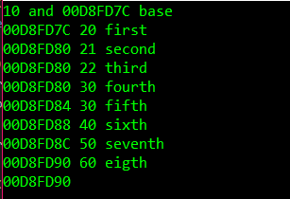
Pointers – incrementing pointers int array[10] = { 10,20,30,40,50,60,70,80,90,100 },
*ptrArray; // ints are 4 bytes
ptrArray = array;
cout << *ptrArray << " and " << ptrArray << " base\n";
cout << ptrArray << ' '; cout << *++ptrArray << " first\n"; //advance ptr, dereference to print
cout << ptrArray << ' '; cout << ++*ptrArray << " second\n"; //dereference & incr value then print
cout << ptrArray << ' '; cout << ++(*ptrArray) << " third\n"; //same as ‘second’
cout << ptrArray << ' '; cout << *(++ptrArray) << " fourth\n"; //same as ‘first’
cout << ptrArray << ' '; cout << *ptrArray++ << " fifth\n"; //dereference to print, advance ptr
cout << ptrArray << ' '; cout << *(ptrArray)++ << " sixth\n"; //same as fifth
cout << ptrArray << ' '; cout << *(ptrArray++) << " seventh\n"; //same as first
cout << ptrArray << ' '; cout << (*ptrArray)++ << " eigth\n"; //dereference to print, incr value
cout << ptrArray;

Slide 14
Pointers – incrementing pointers, summary *++ptrArray //advance ptr, dereference to get value
*(++ptrArray)
*(ptrArray++)
++*ptrArray //dereference & incr value then get value
++(*ptrArray)
*ptrArray++ //dereference to get value, advance ptr
*(ptrArray)++
(*ptrArray)++ //dereference to get value, incr value

Slide 15
Pointers – incrementing pointers
int main(int argc, const char * argv[]) // used to pass arguments into main
int main(int argc, const char * * argv)

Slide 16
Computer Memory
Code where program is stored Static Memory global variables Stack local variables added by function call removed by function exit Heap free memory used by new returned by delete

Slide 17
Computer Memory
Memory leaks occur when new is used and not followed correctly with delete
- extremely difficult to uncover in one’s code

Slide 18
Destructor
Simple class:
class Simple { private: int * intPtr; public: Simple() { intPtr = new int; } //example of in-line function ~Simple() { delete intPtr; } int main() { Simple simple; //calls default constructor, which generates new memory for int .
.
.
return( 0 );
} //calls destructor, which frees memory generated in constructor //program exit frees up memory for all declared variables

Slide 19
Copy Constructor – required if class is passed as parameter by-value
Simple class:
class Simple { private: int * intPtr; public: Simple() { intPtr = new int; } //example of in-line function ~Simple() { delete intPtr; } int main() { Simple simple; //calls default constructor, which generates new memory for int .
. Max( simple ); //pass-by-value, calls default constructor . //which duplicates value stored in intPtr and . //destructor frees it when Max exits
.
return( 0 );
} //destructor tries to again free memory pointed to by intPtr but can’t

Slide 20
Copy Constructor – required if class is passed as parameter by-value
Simple class:
class Simple { private: int * intPtr; public: Simple() { intPtr = new int; } //example of in-line function Simple( const Simple & original ) {intPtr = new int; *intPtr = *(original.intPtr); } //copy constructor ~Simple() { delete intPtr; } int main() { Simple simple; //calls default constructor, which generates new memory for int .
. Max( simple ); //pass-by-value, calls copy constructor . //which duplicates content stored in intPtr and . //destructor frees it when Max exits
.
return( 0 );
} //destructor successfully frees memory pointed to by intPtr

Slide 21
Copy assignment operator – required if class contains pointer variables
int main() { Simple A, B; A = B; //copies all values in B to A, including pointers //same issue as passing pointers-by-value

Slide 22
Copy assignment operator – required if class contains pointer variables
Solution: override = operator for the class Simple& Simple::operator=( const Simple& oldObj ) { if (this != &oldObj ) //if not doing A=A { delete intPtr; intPtr = new int; *intPtr = *(oldObj.intPtr); } return *this; }

Slide 23
Rule of Three
If class contains a pointer attribute or otherwise allocates memory 1. create destructor 2. create copy constructor 3. overload assignment operator

Slide 24
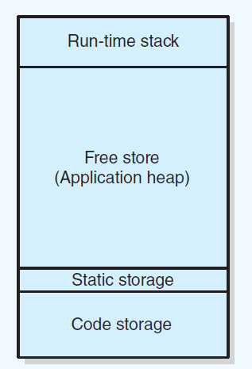
Pointers and Program’s Free Store
Sample program memory layout
declared variables
allocated memory

Slide 25
Deallocating Memory
When memory to which pointer variable points is no longer needed
Deallocate it by using delete operator.
Then set pointer variable to nullptr
Otherwise dangling pointer exists
It would still contain address of object that was deallocated.
Can be source of serious errors.

Slide 26
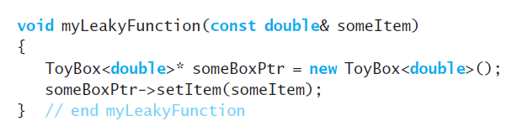
Avoiding Memory Leaks
Memory leaks occur when
An object has been created in the free store, but
Program no longer has a way to access
Poorly written function that allocates memory in the free store

Slide 27
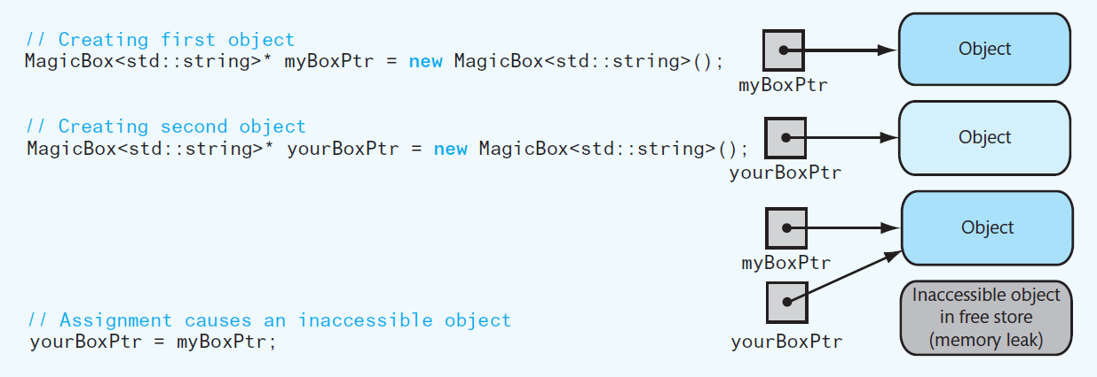
Avoiding Memory Leaks
An assignment that causes an inaccessible object.
To prevent memory leak, do not use a function to return a pointer to a newly created object

Slide 28
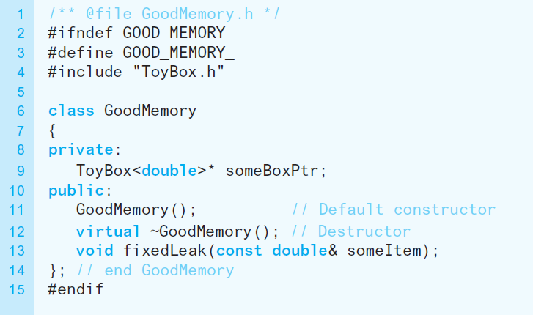
Avoiding Memory Leaks
Header file for the class GoodMemory

Slide 29
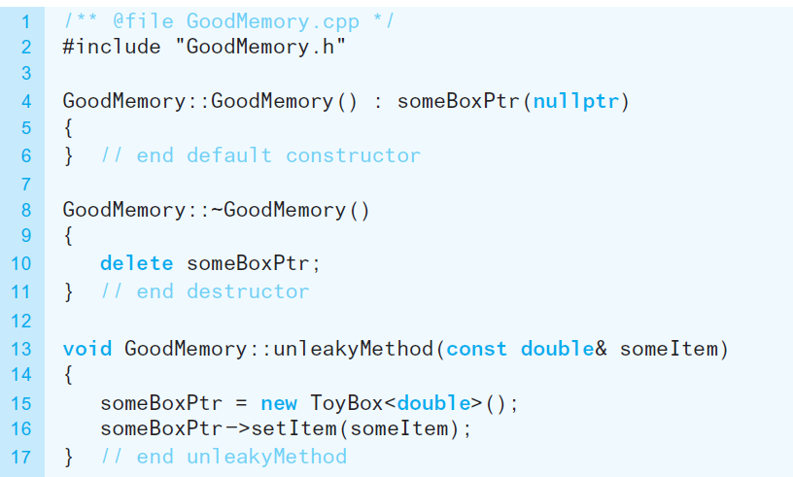
Avoiding Memory Leaks
Implementation file for the class GoodMemory

Slide 30
Avoiding Dangling Pointers
Situations that can cause dangling pointer
if you do not set a pointer variable to nullptr after using delete
If you declare a pointer variable, do not assign it a value, but use it

Slide 31
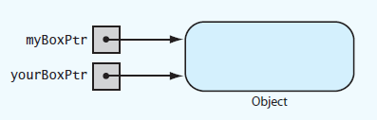
Avoiding Dangling Pointers
Two pointers referencing (pointing to) the same object

Slide 32
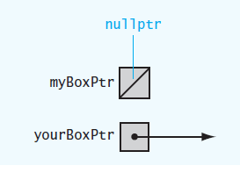
Avoiding Dangling Pointers
Example of a dangling pointer

Slide 33

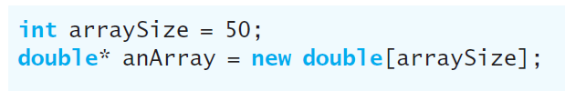
Dynamic Allocation of Arrays
An ordinary C++ array is statically allocated
Can use new operator to allocate an array dynamically

Slide 34

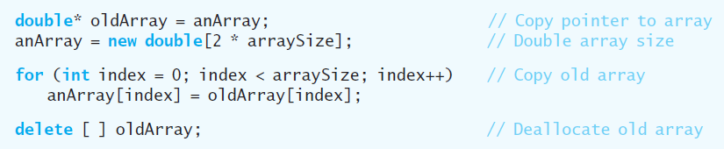
Dynamic Allocation of Arrays
delete returns a dynamically allocated array to system for reuse
Increase size of dynamically allocated array

Slide 35
Pointers, Polymorphism, and Memory Allocation

Slide 36
Memory Allocation for Variables and Early Binding of Methods
Declare variable x to have data type int
C++ compiler allocates memory cell to hold an integer
Use the identifier x to refer to this cell
A function’s locally declared variables
Placed into an activation record with parameters and bookkeeping data
Activation record placed on run-time stack
Activation record destroyed when function finished

Slide 37
Memory Allocation for Variables and Early Binding of Methods
Storage for data members of an object
Also placed into an activation record.
Data fields placed on the run-time stack just as primitive data types are.
This is early binding , made during compilation
Cannot be altered during execution

Slide 38
Memory Allocation for Variables and Early Binding of Methods
Automatic memory management and early binding sometimes insufficient
Need to take advantage of polymorphism.
Must access an object outside of the function or method that creates it.

Slide 39
Problem to Solve
Need to write a function – takes two arguments:
An object of any of the three types of boxes (from Interlude 1)
An item of type string
Function should place item in box by invoking box’s setItem method

Slide 40
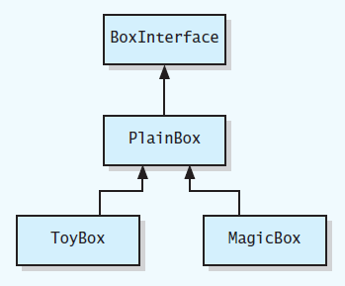
Problem to Solve
UML class diagram for a family of classes

Slide 41
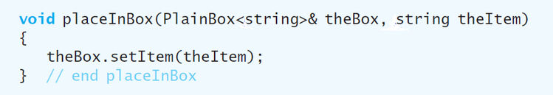
Problem to Solve
You may think this function would suffice

Slide 42
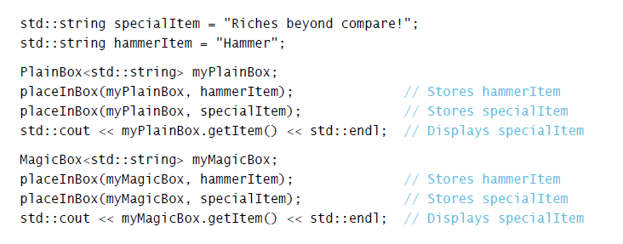
Problem to Solve
Used in this context
Code compiles, but does not perform as you would expect due to

Slide 43
Problem to Solve
Version of setItem called is determined when the program is compiled.
Need a way to communicate to compiler
Code to execute should not be determined until program is running.
Called late binding

Slide 44
Pointers and Program’s Free Store
Sample program memory layout

Slide 45
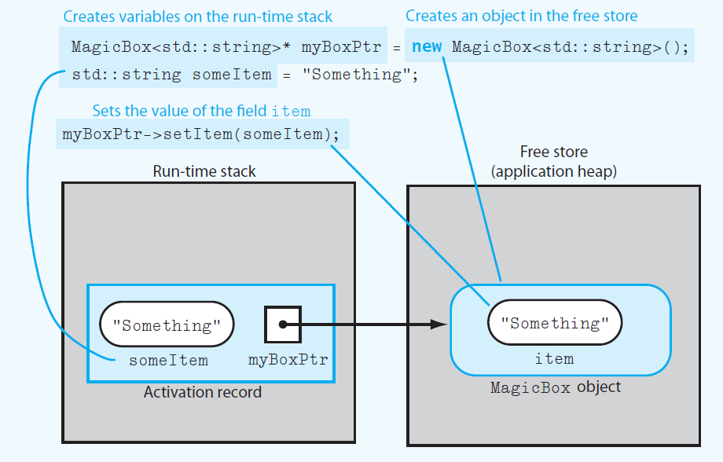
Pointers and Program’s Free Store
Run-time stack and free store after myboxPtr points to a MagicBox object and its data member item is set

Slide 46
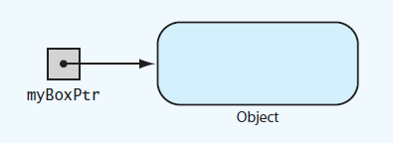
Pointers and Program’s Free Store
myBoxPtr and the object to which it points

Slide 47
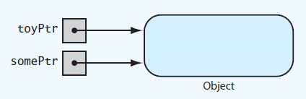
Pointers and Program’s Free Store
Two pointer variables that point to the same object

Slide 48
Deallocating Memory
When memory to which pointer variable points is no longer needed
Deallocate it by using delete operator.
Then set pointer variable to nullptr
Otherwise dangling pointer exists
It would still contain address of object that was deallocated.
Can be source of serious errors.

Slide 49
Avoiding Memory Leaks
Memory leaks occur when
An object has been created in the free store, but
Program no longer has a way to access
Poorly written function that allocates memory in the free store

Slide 50
Avoiding Memory Leaks
An assignment that causes an inaccessible object.
To prevent memory leak, do not use a function to return a pointer to a newly created object

Slide 51
Avoiding Memory Leaks
Header file for the class GoodMemory

Slide 52
Avoiding Memory Leaks
Implementation file for the class GoodMemory

Slide 53
Avoiding Dangling Pointers
Situations that can cause dangling pointer
if you do not set a pointer variable to nullptr after using delete
If you declare a pointer variable, do not assign it a value, but use it

Slide 54
Avoiding Dangling Pointers
Two pointers referencing (pointing to) the same object

Slide 55
Avoiding Dangling Pointers
Example of a dangling pointer

Slide 56
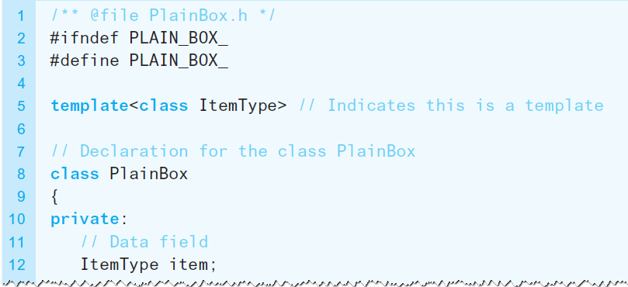
Virtual Methods and Polymorphism
Allow compiler to perform the late binding necessary for polymorphism
Declare methods in base class as virtual.
Revised header file for the class PlainBox

Slide 57
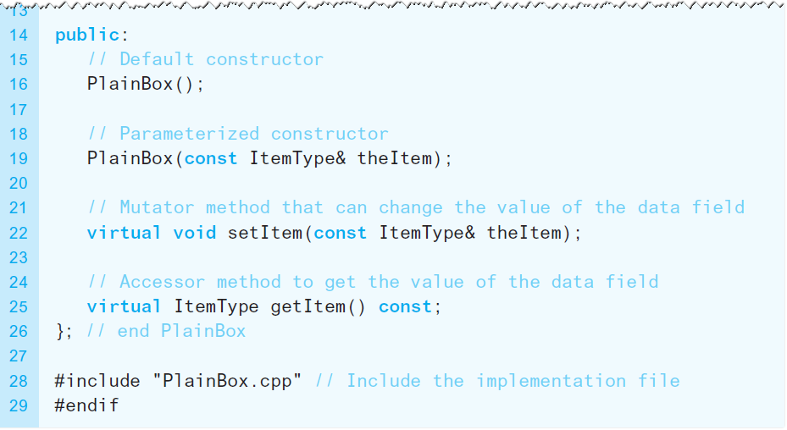
Virtual Methods and Polymorphism
Revised header file for the class PlainBox

Slide 58
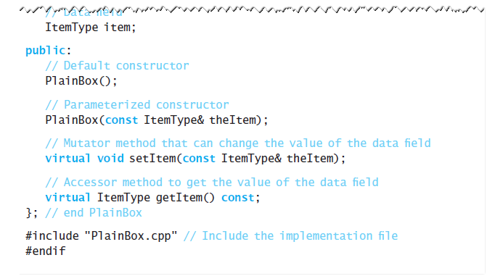
Virtual Methods and Polymorphism
Revised header file for the class PlainBox

Slide 59
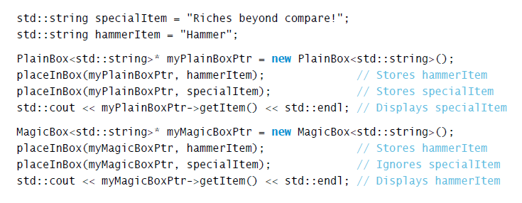
Virtual Methods and Polymorphism
To fully implement late binding, create variables in free store and use pointers to reference them

Slide 60
Dynamic Allocation of Arrays
An ordinary C++ array is statically allocated
Can use new operator to allocate an array dynamically

Slide 61
Dynamic Allocation of Arrays
delete returns a dynamically allocated array to system for reuse
Increase size of dynamically allocated array

Slide 62
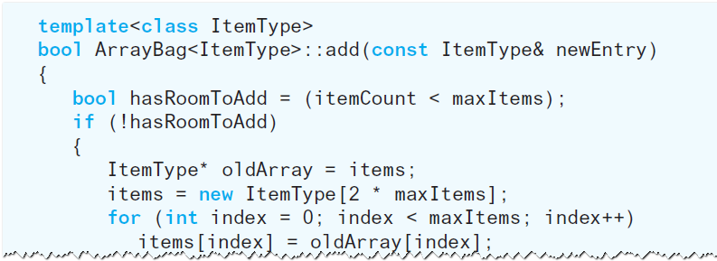
A Resizable Array-Based Bag
Use a resizable array to implement ADT bag so that bag never becomes full

Slide 63
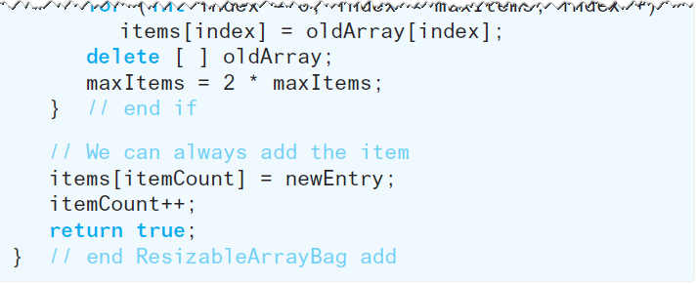
A Resizable Array-Based Bag
Use a resizable array to implement ADT bag so that bag never becomes full

